Slide 1
Learning Automata Based Sentiment Analysis for Recommender System on Cloud
Under the esteemed guidance
Of
Dr.Humera Khanam, Professor
Department of Computer Science And Engineering
SV University, Tirupati
By
N.VeerendraReddy
1115602

Slide 2
Contents
Introduction
Abstract
Existing Work
Drawbacks
Proposed Work
Requirements
Results
Conclusion
Future Scope
References

Slide 3
Introduction
Recommender systems help users by predicting the best among the available products or services and thus facilitates for making quick decision to the users
These systems are capacitated to predict suggestions that a user would give it on an item or any social entity
Recommender systems can produce recommendations by two approaches:-
Collaborative filtering
Content-based filtering.

Slide 4
Collaborative filtering:- This is one of the major approaches used for recommender systems that depend on the opinions and views expressed by other users
Eg: Foursquare recommends places based on the previous
check-ins of the user.
Content-based filtering:- This approach analyzes a series of different characteristics of an item in order to recommend other items with similar properties.
Eg: Flipkart.com suggests items based on the number of people
purchasing an item and the feedback on the item.
Both of these approaches are often combined and are termed as Hybrid Recommender Systems

Slide 5
Abstract
The development of personalized recommendation systems has been an interesting research topic after the rapid evolution in social networking sites.
We propose a recommendation system using Learning automata (LA) and sentiment analysis.
The proposed Learning Automata-Based Sentiment Analysis System (LASA) recommends the places nearby the current location of the users by analyzing the feedback from the places and thus calculating the score based on it.

Slide 6
Existing Work
A variety of methods have been proposed to quantify the extent of bias in traditional news media.
Indirect methods involve linking media outlets to reference points with known political positions.
Entities’ stances on various issues can be directly observed through history and other types of data

Slide 7
Drawbacks
There is no real time data in existing system.
3rd person intervention and scope of manipulation of results.
Processing a result takes a long time and no dynamic response.
No trending data and pictorial representation.
Only statistical analysis that concludes decision.
No cloud entity system.

Slide 8
Proposed Work
We have proposed a system that is useful in case when a user goes to a new place and needs some good recommendations for different items
Based on the previous feedbacks on the places related to the queried item nearby the user, the proposed system builds score analysis with the help of “Sentiment analysis”.
Sentiment analysis is an approach to find out users’ opinions and helps in identifying positive and negative responses, emotions and views

Slide 9
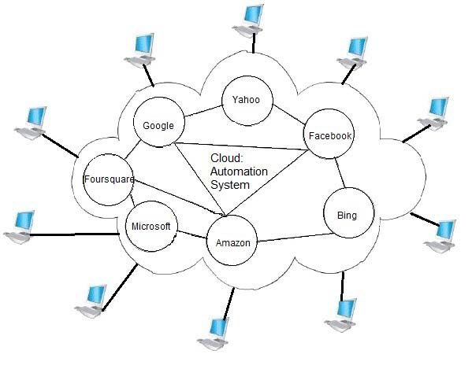
Our system uses LA along with sentiment analysis to perform the score analysis based on the users past responses on a particular item or place.
The system has been integrated with a cloud platform.
Fig. Cloud-based Recommender System

Slide 10
Learning Automata(LA)
This model has three main components:-
Automaton:- It learns the characteristics of the Environment and identifies “optimal” actions that can be performed on the Environment
It can be represented as a quintuple represented as {Q, A, B, F},
Q: is the finite set of internal states Q = {q1,q2,q3 ….qn}, where
qn is the state of the automaton at instant n.
A: is a finite set of actions performed by the automaton. A= {α1,
α2 …. αn}, where αn is the action performed by the automaton
at instant n.
B: is a finite set of responses from the environment. B ={β1, β2, β3
… βn}, where βn is the response from the environment at an
instant n.
F: is a mapping function. It maps the current state and input to the
next state of the automaton. Q x B Q.

Slide 11
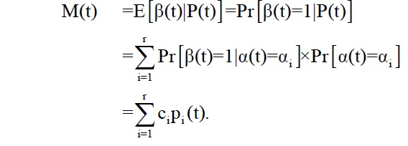

2) Environment:- It corresponds to the medium in which the Automaton functions.
It can be abstracted by a triple {A, B, C}. Here, A, B have already been defined earlier and C = {c1 , c2 ,…,cr} is a set of penalty probabilities, where element ci∈ C corresponds to an input action αi.
3) Reward/Penalty:- Given an action probability vector P(t) at time ‘t’, the average penalty, M(t), is defined as
Average penalty for the “pure-chance” automaton is given by

Slide 12
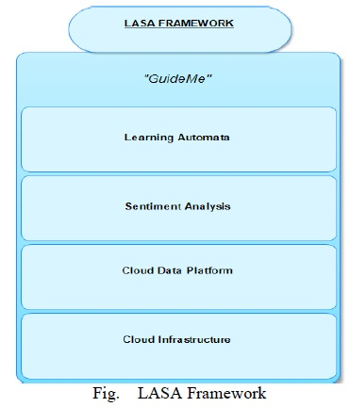
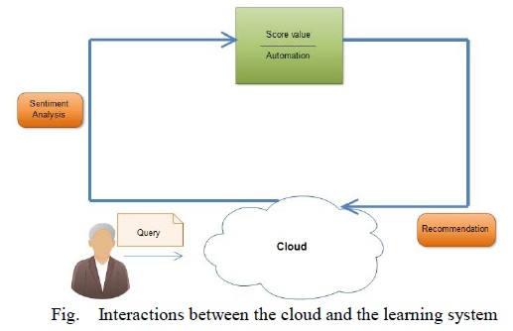
System Model
System Model is an integration of LASA Framework and interaction between the cloud and the learning system and
LA is used to give collaborative filtering based on the user's previous experience and activities. The given application "GuideMe” helps in providing better personalized recommendations.

Slide 13
LEARNING AUTOMATA-BASED SENTIMENT ANALYSIS(LASA)
The LASA framework consists of three phases, namely identification of geo-location, sentiment analysis and learning phase.
Geo-Location:-A request is to be sent to the device to allow identifying its location.
Sentiment analysis:- The comments and the user’s feedback are fetched and processed for sentiment analysis for getting a positive or negative classification on it.
Learning Phase:-The learning phase bases on the user’s previous history, including the feedback and check-ins at various places and comments on it,

Slide 14
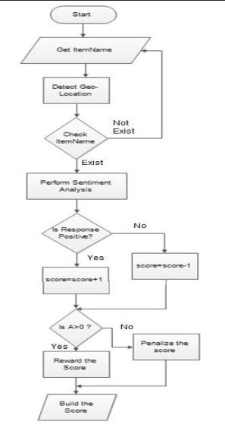
System strategy

Slide 15
Requirements
Software
Cloud Service Phpfog-Amazon Web Services Data Sets Foursquare
Network Analyzer Tool
Pingdom Sentiment Analysis classifier
Viralheat Visualization HighCharts
Hardware
Intel Dual core 2Ghz
RAM 2GB
HDD 150GB

Slide 16
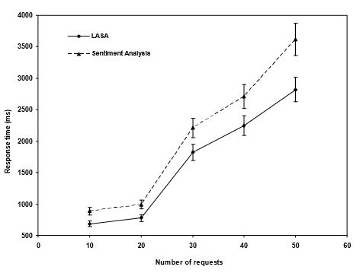
Results

Slide 17
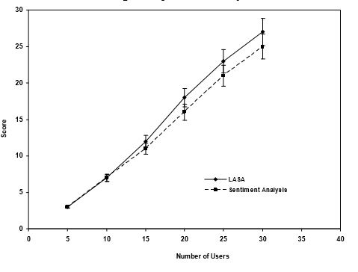

Slide 18
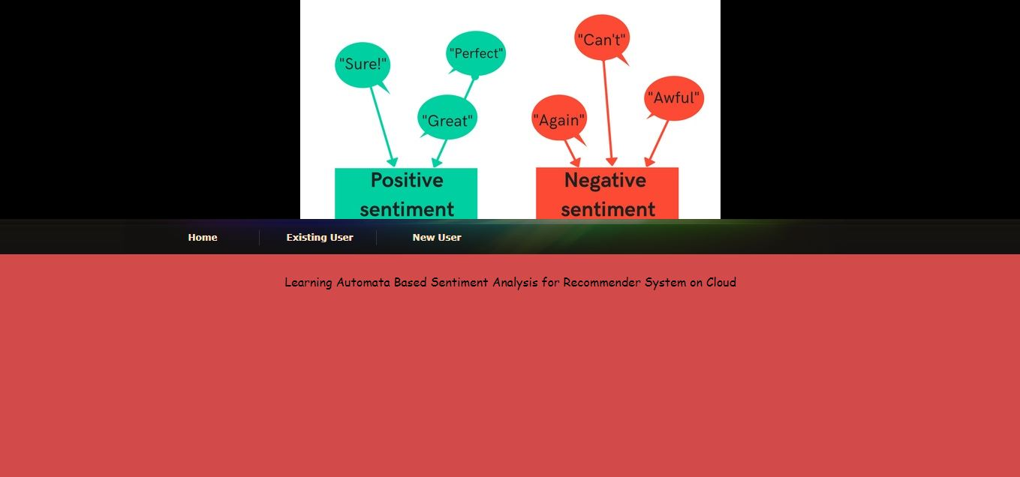

Slide 19
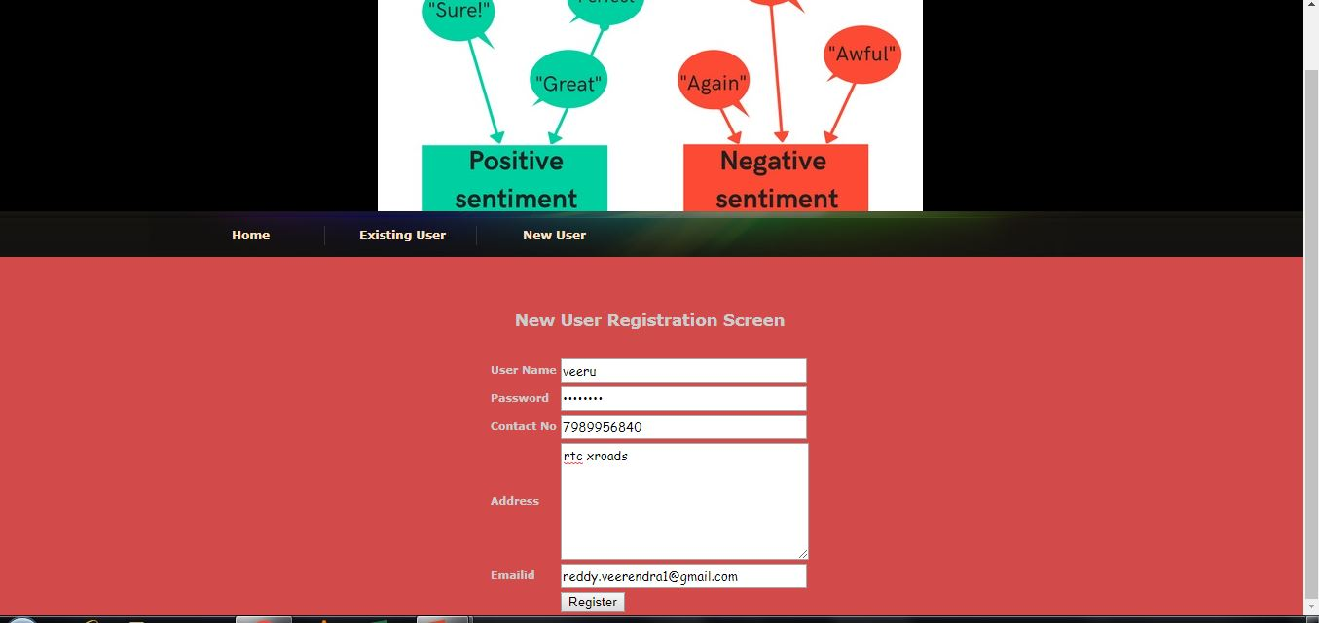

Slide 20


Slide 21
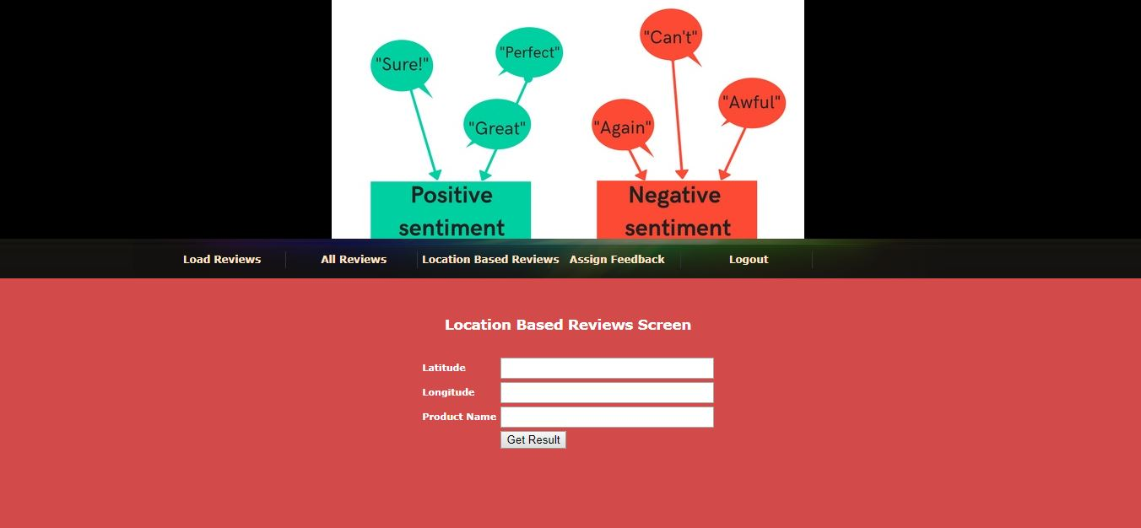

Slide 22
Conclusion
Recommender systems are playing major role in assisting users for various aspects of their requirements.
Using LA with sentiment analysis helps to get personalized recommendations based on the previous experiences of the users.
We demonstrate that LASA improves the efficiency of the recommender system and help user in locating items more efficiently and closely to what they are actually looking for. Secure aspects of recommender systems would be future investigation of the LASA framework.

Slide 23
Future Scope
Finally, we would like to investigate the integration of the LASA framework in other problem domains involving cellular networks, ad hoc networks, sensor networks, and IEEE 802.11-based networks.

Slide 24
References
A. Felfernig, G. Friedrich and L. Schmidt, “Introduction to the IEEE Intelligent Systems Special Issue: Recommender Systems”, IEEE Intelligent Systems, Vol. 22,No. 3, pp. 18-21, May/June 2007.
Foursquare API, https://foursquare.com
K. Najim and A. S. Poznyak, Learning Automata: Theory and Applications, Pergamon Press, Oxford, U.K., 1994.

Slide 25
Thank You

